Slide 1

Player’s Guide

Slide 2
The Game - Context
A competitive game played between two teams at a time
A virtual world where programmed devices will play against each others
Each team implements strategy on a device. The devices play autonomously against each others. Each device is called Node.

Slide 3
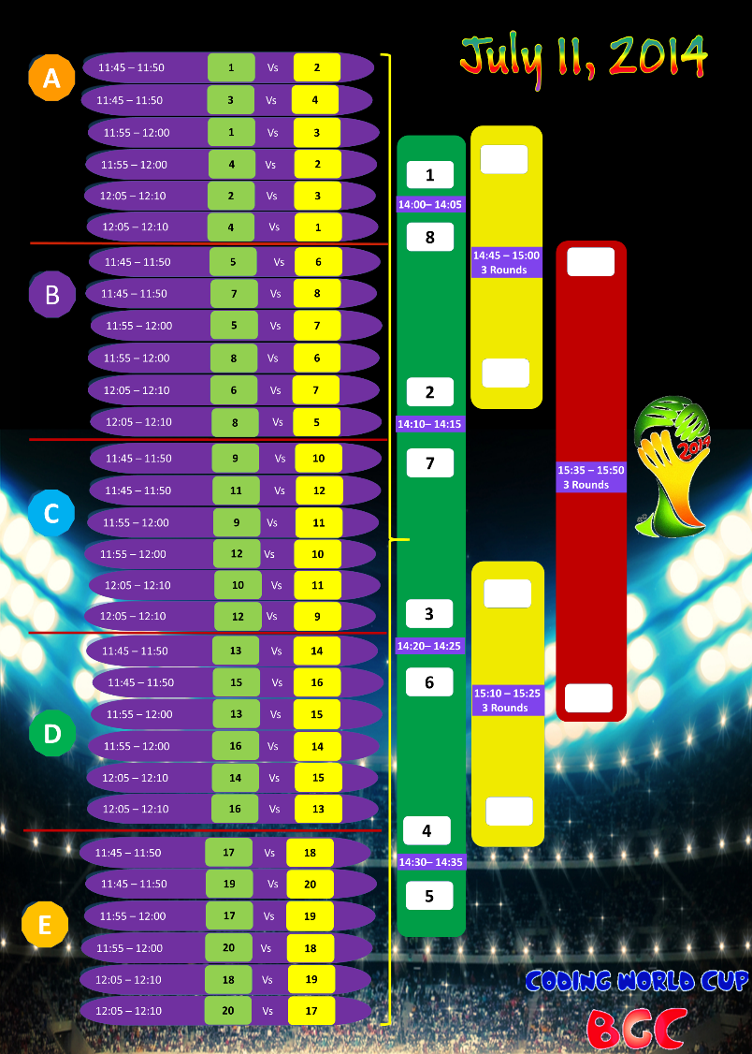
The Game - Rounds
Teams go through qualifications then elimination rounds until the final match between two remaining teams
During qualifications all teams in each group compete against each other.
The top 8 qualifying move to ¼ finales
½ and finales will include 3 rounds between each teams. Map parameters may be changing between different rounds (reservoir size and capacity).

Slide 4

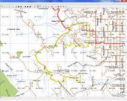
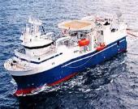

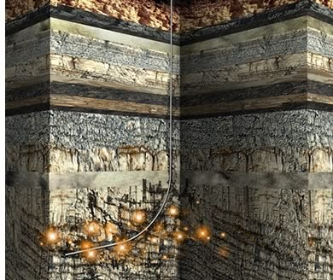
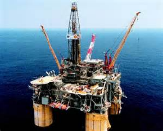
The Game - Objectives
The game map
Oil
Oil
Oil
Oil
Oil
Before each game between two teams, a game map is generated (randomly)
The game map represent a virtual reservoir with oil reserves
Each team has objective to purchase, explore, drill, stimulate and produce
Winning team is the one that has the most money compared to the other team Or in case no money left for all teams, winner is the one that produced the most No money left means none of the team have more than $30,000 left in bank.
Special prizes for innovation, team spirit and learning will be awarded
Oil
Oil
Oil
Purchase Rights
Explore
Drill
Stimulate
Produce

Slide 5
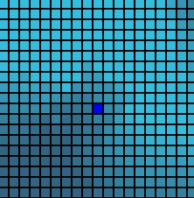
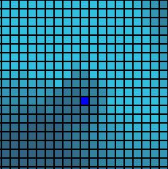
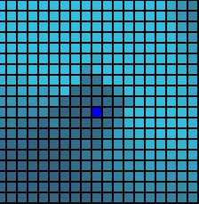
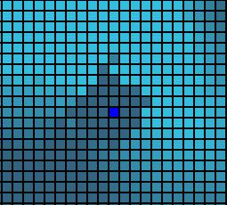
The Game - Challenges
Each team starts with the same fixed amount of money
Each team is unaware of the opponent progress
Each team is unaware of the game map reservoir nature
During each game, each device takes turn to decide what action to take. Example: Purchase reservoir block at coordinate X,Y
Each action has a cost. Some actions can be done using different providers Example: Explore with Schlumberger (higher price but more accurate results)
Once viable purchases developed (successful drilling in a reservoir), production will start depleting the reservoir (including surrounding area)
DEPLETING RESERVOIR

Slide 6


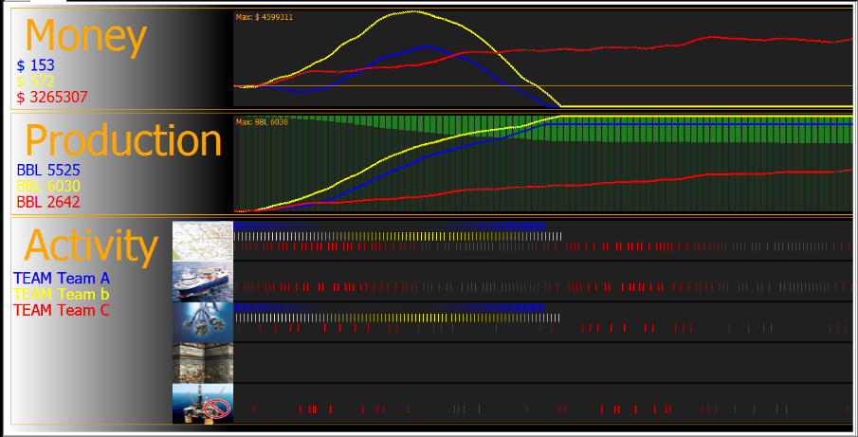
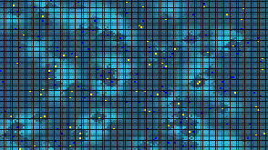
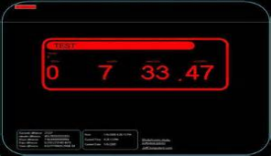
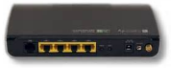
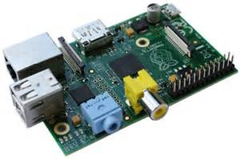

Competition Environment
Game Server
Team A Node
Team B Node

Slide 7
Developer Environment
Team Node
Raspberry PI Device
SD Card contains the operating system
HTTP Web Server
Screen, Keyboard & Mouse, local network behind router
Each team can use their own computer to connect with their node during development. Devices operate autonomously during competition.
A test server or set of test servers are made available for teams to test their code.
Test application is locally installed that can run the game server simulation engine.

Slide 8



Developer Environment
Local Network
Typically 192.168.20.xxx
PI can be connected to a screen using HDMI, and USB Keyboard & Mouse.
This provide X-Window environment
Alternative/combination: your computer can connect to the PI using SSH (PUTTY for example)
Cygwin can also be used as X window terminal from your computer. In this case additional screen, keyboard & mouse not needed.
Team Node
uUSB
HDMI
WiFi
RJ45
Keyboard & Mouse
Note: do not change the preconfigured IP of the Pi
Note: we recommend to change default password of Pi

Slide 9
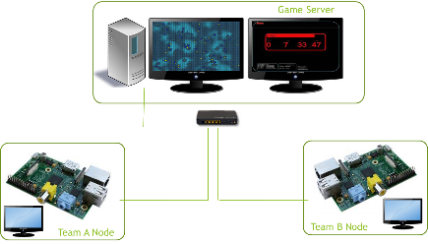
Game Architecture
The Game Server is the master, nodes are slaves
The game server is configured to contact turn by turn each nodes
The game server uses HTTP protocol to dialog with the node.
The embedded web server in each Raspberry PI receives the web request and responds
The response from the Raspberry PI node to the server conditions the next action.
The action sent back from the node to the master may succeed or fail. The result of the action is given back by the server in the following turn.
The Pi has to be able to start automatically and ready to play after reboot (no manual configuration on the Pi itself)

Slide 10
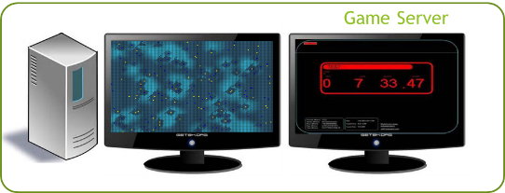
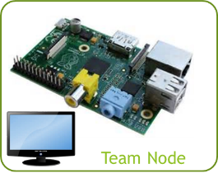
Game Architecture - Sequence
HTTP POST
Provides
Bank balance $
Width and Height of game world
Last operation status and additional information
Respond as a web page the next action
Examples:
Purchase at given coordinate
Explore at given coordinates
Drill at given coordinates
Web page is generated using program written in PHP or other available languages available (team can upgrade the operating system and software on the Raspberry PI).
HTML Reply

Slide 11
Game Architecture – Sequence Example
Money=$1,000,000
Width=96
Height=64
Last Operation=Purchased
Last Operation=Success
Stores the successful purchase of block
Request exploration at same coordinates
<Execute>Explore</Execute>
<ExploreAtX>30</ExploreAtX>
<ExploreAtY>12</ExploreAtY>
<ServiceProvider>SLB</ServiceProvider>
HTML Reply
Money=$9,090,000
Width=96
Height=64
Last Operation=Explore
Last Operation=Success
Last Operation Value=10 mbl oil potential
Stores the successful exploration of block
Request drilling at same coordinates
<Execute>Drill</Execute>
<DrillAtX>30</DrillAtX>
<DrillAtY>12</DrillAtY>
<ServiceProvider>SLB</ServiceProvider>
HTML Reply

Slide 12

Game Rules
Developers will not attempt to execute their own requests to the server The implementation on the Raspberry PI node will only respond to incoming HTTP requests and respond using HTML generated code.
Developers will ensure the response is made within one second at most by the Raspberry PI. No attempt shall be made by developer to willingly stall the response to the game server in attempts to impact the outcome of the game
Developers will make best attempts to follow the API guide provided and not attempt to cause willingly unexpected data sent to the game server. If server fails due to team invalid response leads to team match lost.
Developers will not attempt to gain access or reverse engineer the game server system Developers will not attempt to interfere with other player’s Pis
IT Rule: DO NOT connect the Raspberry Pi to Schlumberger Network.
Any infringement to those rules will lead to sanctions up to potential disqualification

Slide 13
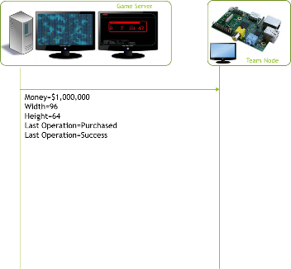
Developer API Guide - POST
POST Information provided by game server to Pi Node
Always provided Example
round A counter incrementing 123 Note: 0 means 1st Round (Reset…)
money Balance of money for this node 1000000
width Width of game map 96
height Height of game map 64
index Unique index of team (assigned by server) 1
Production List of coordinate and total production number 4,5,12 10,12 5 Pattern {X,Y,P_}* _ means space
Conditionally provided
lastoperation Can be one of Buy Explore Stimulate Drill
lastoperationstatus Can be one of True False (described for each operation in further slides)
lastoperationvalue Depends on lastoperation: For Explore, estimated reservoir content value For Drill, updated estimated reservoir content value
Note 1: typically post information are retrieved as strings in the node
Note 2: the URI (Uniform Resource Identifier) for the POST is entered in the game server for each node competing. This URI may also be used using GET (simple page access) by game server to determine the Pi Node is up and running. This should be gracefully handled by the Pi Node (Example URI: http://192.168.20.11/play.php)

Slide 14
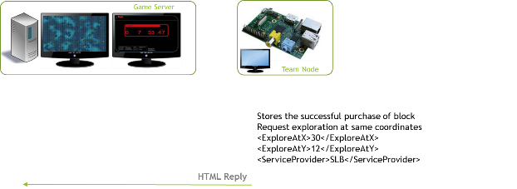
Developer API Guide - Buy
Response are provided by node to the game server as HTML page The page can contain actions requested to the game server:
Purchase of a block for right of exploration <Execute>Buy</Execute> <BuyAtX>123</BuyAtX> <BuyAtY>456</BuyAtY> The server will respond in next post the success of this request. A purchase may fail for the following reasons: Out of bound (coordinates not in map area) Not available (already purchased by the another node) Insufficient funds (can not proceed to purchase) POST will provide in the next turn: lastoperation=Buy lastoperationstatus=True or False in case of success or failure (see above) lastoperationvalue undefined in this context
Note: non recognized commands are discarded by the server. Additional information generated in the page are logged on the game server.

Slide 15
Developer API Guide - Explore
Response are provided by node to the game server as HTML page The page can contain actions requested to the game server:
Exploration of a block Once successfully purchased, a block can be explored. <Execute>Explore</Execute> <ExploreAtX>123</ExploreAtX> <ExploreAtY>456</ExploreAtY> <ServiceProvider>SLB</ServiceProvider> Service provider can be or SLB or HAL. Accuracy/Pricing differs between providers. . Costs are provided in Economics section. The server will respond in next post the success of this request. An exploration may fail for the following reasons: Out of bound (coordinates not in map area) Not available (does not own that block) Insufficient funds (can not proceed to purchase) Unknown provider
POST will provide in the next turn: lastoperation=Explore lastoperationstatus=True or False in case of success or failure (see above) lastoperationvalue=123 The estimated reserve after successful exploration (if status is false, this is undefined)

Slide 16
Developer API Guide - Drill
Response are provided by node to the game server as HTML page The page can contain actions requested to the game server:
Drilling of a block Once successfully purchased, a block can be drilled. <Execute>Drill</Execute> <DrillAtX>123</DrillAtX> <DrillAtY>456</DrillAtY> <ServiceProvider>SLB</ServiceProvider> Service provider can be or SLB or HAL. Accuracy/Pricing differs between providers. Costs are provided in Economics section. The server will respond in next post the success of this request. A drilling may fail for the following reasons: Out of bound (coordinates not in map area) Not available (does not own that block) Insufficient funds (can not proceed to purchase) Unknown provider
POST will provide in the next turn: lastoperation=Drill lastoperationstatus=True or False in case of success or failure (see above) lastoperationvalue=123 The updated estimated reserve after successful exploration (LWD/MWD) (if status is false, this is undefined)
Once drilled, the reservoir will start producing; the production reported by the game server.

Slide 17
Developer API Guide - Stimulate
Response are provided by node to the game server as HTML page The page can contain actions requested to the game server:
Stimulate of a block Once successfully purchased and drilled, a block can be stimulated to increase productivity (at any time). <Execute>Stimulate</Execute> <StimulateAtX>123</StimulateAtX> <StimulateAtY>456</StimulateAtY> <ServiceProvider>SLB</ServiceProvider> Service provider can be or SLB or HAL. Recovery Performance/Pricing differs between providers. The server will respond in next post the success of this request. A stimulation may fail for the following reasons: Out of bound (coordinates not in map area) Not available (does not own that block) Insufficient funds (can not proceed to purchase) Unknown provider
POST will provide in the next turn: lastoperation=Stimulation lastoperationstatus=True or False in case of success or failure (see above) lastoperationvalue=123 The updated estimated reserve after successful stimulation (if status is false, this is undefined)
The stimulation can be done at any time once reservoir is drilled.

Slide 18
Developer API Guide – StopProduction
Response are provided by node to the game server as HTML page The page can contain actions requested to the game server:
Stop production of a block. As producing block has a cost, if the block is not sufficiently producing, stopping production operation can cut operational costs.
Once successfully drilled, the production can be stopped: <Execute>StopProduction</Execute> <StopProductionAtX>123</StopProductionAtX> <StopProductionAtY>456</StopProductionAtY> The server will respond in next post the success of this request. A production stop may fail for the following reasons: Out of bound (coordinates not in map area) Not available (does not own that block)
POST will provide in the next turn: lastoperation=StopProduction lastoperationstatus=True or False in case of success or failure (see above)
Unless StopProduction is executed, production operations continue even if no oil is produced.

Slide 19

Developer API Guide - Extensions
You can consider using additional features from the Raspberry PI.
Team Node
For example, a browser can access web server in PI
You can display valuable information during development
uUSB
HDMI
WiFi
RJ45
Keyboard & Mouse

Slide 20

Developer Guide – Team Development
Understand the platform capability and openness
Leverage the flexibility for
Development
Testability
Designs of experiments

Slide 21
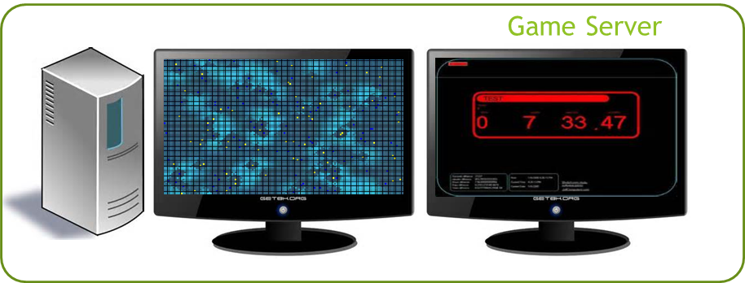
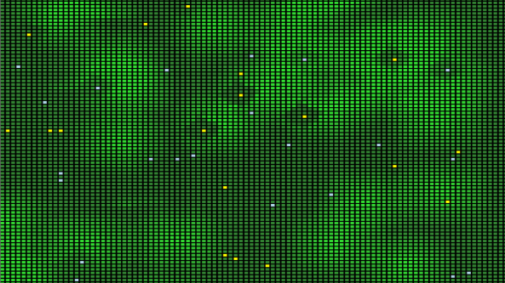
Game Server
Game Server program is provided to each team.
Requires Windows 7 x64 and .NET 4.0 runtime.

Slide 22
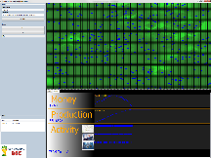
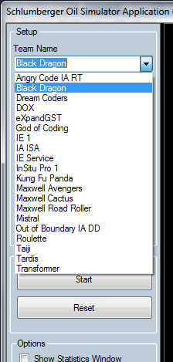
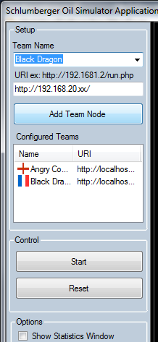
Game Server Usage
Enter Team Name or select predefined and specify URI to your web server
2. Click Add Node
3. Click Start
A full URL is entered before each match, provided by each team. The IP address is expected to be the one assigned for the team device, the remaining of the URL can be specified just before each match.

Slide 23
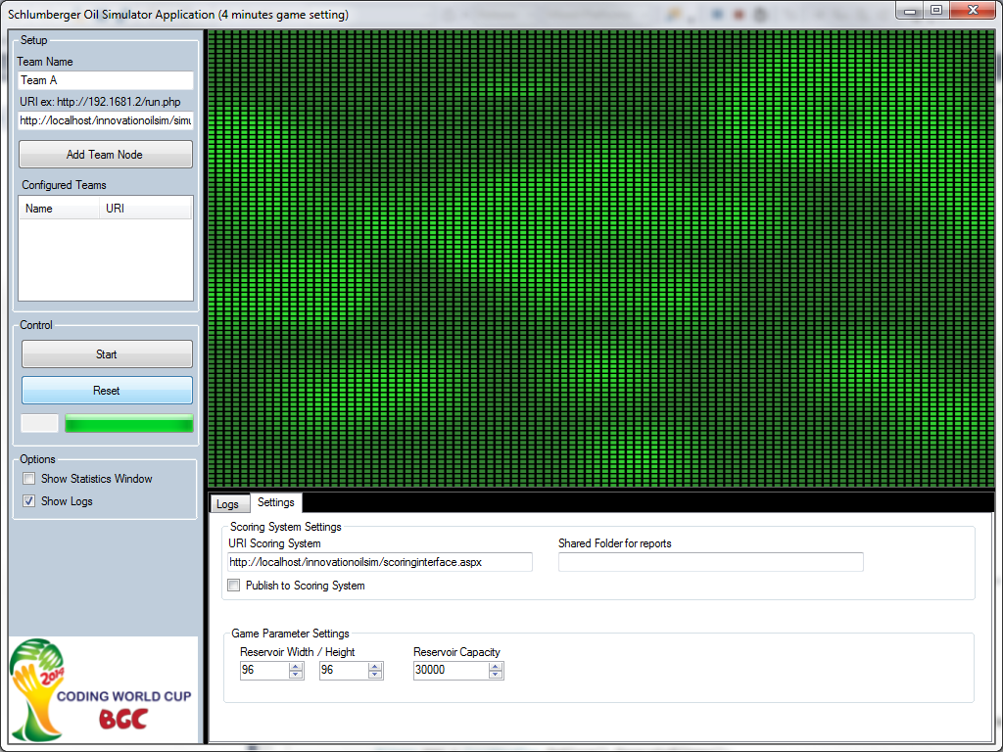
Game Server Usage
Game map parameters can be changed:

Slide 24
Game Server Usage
Log files provide data exchanged between Node and the Game Server
By default located under C:\temp
Can also be seen in Game Server Software (Logs tab)
7/3/2014 10:54:43 PM | Contacting Node
7/3/2014 10:54:43 PM | Executing request NODE (0)
Received Stepped 0<BR>round = 0<BR> Round is now 0<BR> ** RESET **<BR>money = 1000000<BR> Money is now 1000000<BR>width = 96<BR> Width is now 96<BR>height = 96<BR> Height is now 96<BR>index = 0<BR>INDEX =0<BR>production = <BR>do = execute<HR>Created Cells!CELL PRODUCTION PARSING RAW
<execute>Buy</execute><BuyAtX>41</BuyAtX><BuyAtY>11</BuyAtY>
7/3/2014 10:54:43 PM | Execute received [Buy]
7/3/2014 10:54:43 PM | Purchase successful for Team A at 41,11
7/3/2014 10:54:43 PM | Node requesting purchase X=41 Y=11 success:True

Slide 25
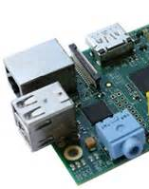
Advanced PI Handling

Slide 26
TECHNICAL INSTALLATION BARE PI to Playing Setup
Default account
User: pi
Password: raspberry
Always shutdown Pi using proper user interface Shutdown or following commands from SSH:
sudo shutdown –h now For a halt/prepare for power off
sudo shutdown –r now For a restart
Editing files when you need privileges
sudo vi /var/www/file.txt
http://www.dingleberrypi.com/2012/09/tutorial-install-apache-php-and-mysql-on-raspberry-pi/

Slide 27
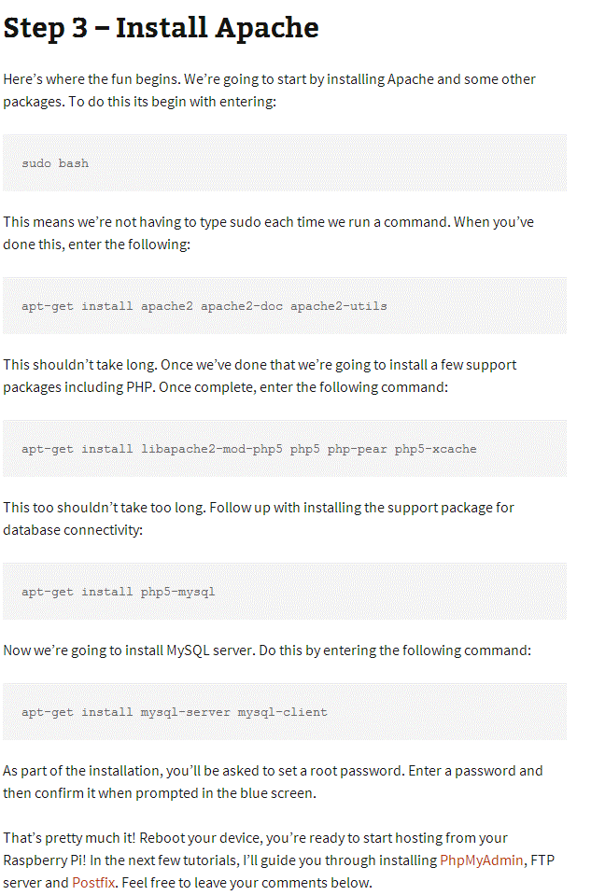
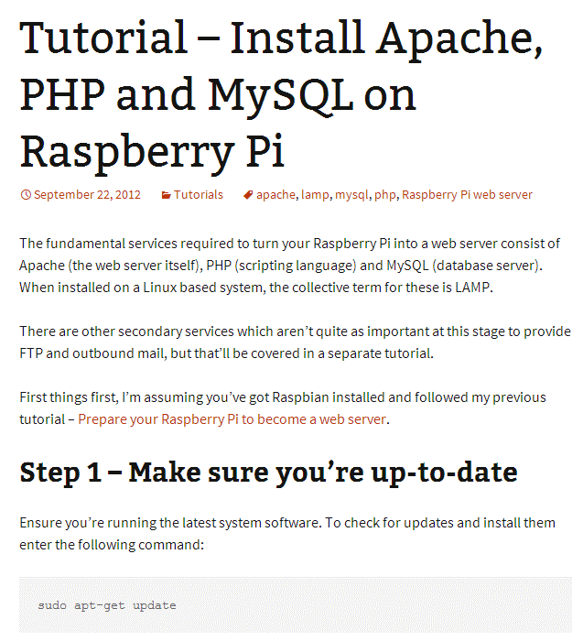
TECHNICAL INSTALLATION BARE PI to Playing Setup
This is an example. You Pi should already have this environment (without MySQL). However you may elect to further upgrade the environment.
Upgrade the system only if connected to NON-SLB network
sudo apt-get update
sudo apt-get install apache2 php5
http://www.dingleberrypi.com/2012/09/tutorial-install-apache-php-and-mysql-on-raspberry-pi/

Slide 28
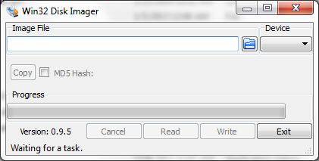
TECHNICAL INSTALLATION BARE PI SD Card Copy/Replication
By default your Pi has been preconfigured with proper static IP address to match your team ID.
Can be used to backup and restore SD cards as image files (keep file system integrity)
The entire state of the Pi is on the SD Card, including default IP address.
In case you need to rebuild your SD card please ask for assistance from team coaches.

Slide 29
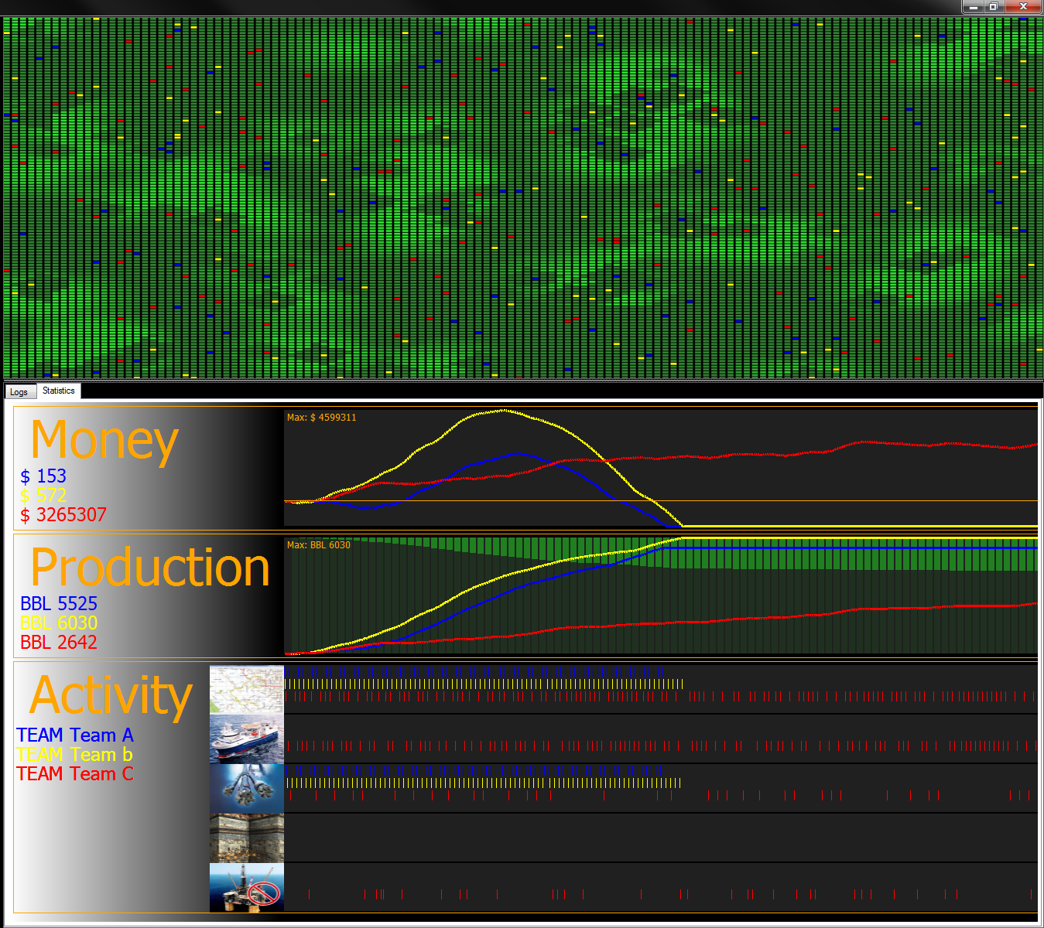
ECONOMICS

Slide 30
Economics (sample - values may change)
Parameters
RESERVOIR_WIDTH = 96; // Reservoir dimension - number of cells – width Min:10 Max: 512
RESERVOIR_HEIGHT = 96; // Reservoir dimension - number of cells - height Min:10 Max: 512
RESERVOIR_BLOCKPRICE = 5000; // Cost of purchase of one cell of the reservoir Min:1000 Max: 100000
RESERVOIR_CAPACITY = 20000; // Total reservoir capacity spread aver the reservoir size
RESERVOIR_CELL_MAXCAPACITY = 10; // Maximum capacity for one cell
COST_OF_PRODUCTION = 1500; // Each producing cell will cost this amount until stopped
COST_OF_SERVICE_EXPLORE_SLB = 7500; // Cost of exploration service - Schlumberger
SERVICE_QUALITY_EXPLORE_SLB = ***; // lower number means lower accuracy of reporting
COST_OF_SERVICE_EXPLORE_HAL = 6500; // Cost of exploration service - Halliburton
SERVICE_QUALITY_EXPLORE_HAL = ***; // lower number means lower accuracy of reporting
NODE_INITIAL_MONEY = 1000000; // Initial money to start working with
OIL_UNIT_PRICE = 2500; // For each unit extracted, owner of rig will get this amount
COST_OF_SERVICE_DRILL_SLB = 20000; // Cost of drilling - Schlumberger
SERVICE_QUALITY_DRILL_SLB = *** // lower number means lower accuracy of reporting
COST_OF_SERVICE_DRILL_HAL = 15000; // Cost of drilling - Halliburton
SERVICE_QUALITY_DRILL_HAL = ***; // lower number means lower accuracy of reporting
COST_OF_SERVICE_STIMULATE_SLB = 20000; // Cost of stimulation - Schlumberger
SERVICE_QUALITY_STIMULATE_SLB = ***; // lower number means lower accuracy of reporting
COST_OF_SERVICE_STIMULATE_HAL = 15000; // Cost of stimulation - Halliburton
SERVICE_QUALITY_STIMULATE_HAL = ***; // lower number means lower accuracy of reporting
* Subject to change during competition

Slide 31
Economics
Potential total cost of exploration
RESERVOIR_WIDTH x RESERVOIR_HEIGHT x COST_OF_SERVICE_EXPLORE_SLB|HAL
Potential oil production revenue
RESERVOIR_CAPACITY * OIL_UNIT_PRICE
Potential oil production net profit
RESERVOIR_CAPACITY x OIL_UNIT_PRICE - COST_OF_PRODUCTION x R x N
R= number of rounds of production
N=number of producing rigs. Because oil is produced from surrounding cells, N can be less than WIDTH x HEIGHT

Slide 32
TEAM <yourteam> 1 Slide Presentation
Describe the team work
Describe the design
Describe the testability
Describe the strategy(ies)

